Slide 1
INTRODUCTION TO DATABASE MANAGEMENT SYSTEM (IDMS)
Lecture 4
Barnali Goswami

Slide 2
Relational Model
Relation: Relation schema (column heads of table) + Relation instance (table)
Relation Schema: Specifies relation name,
Species columns in relation (attribute)'
Provides domain for each attribute
Relation Instance: Set of tuples/records
Tuple: Row in a relation schema

Slide 3
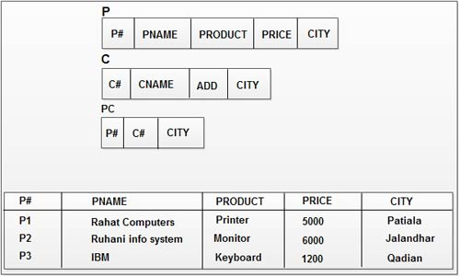
Example of Relation Schema and Relation Instance

Slide 4
Foreign Key
If a relation schema contains the primary key of another relation schema, its called foreign key.
Its used to provide a link between relation schemas.

Slide 5
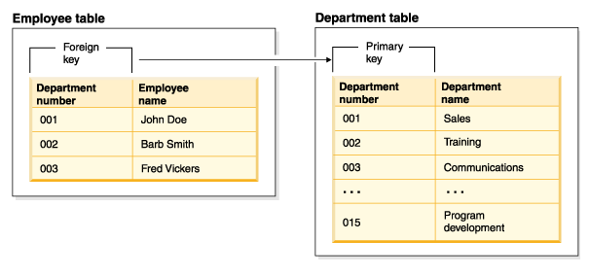
Example of Foreign Key

Slide 6
Relational Algebra
A procedural query language.
Set of operations, taking input as one or more relations and producing a new relation as output.
Fundamental operations:
select
project
union
set difference
cartesian product
rename
Additional operations:
set intersection
natural join
division
assignment

Slide 7

Select
To obtain a subset of the tuples of a relation that satisfy a select condition.
The symbol used for select is:

Slide 8
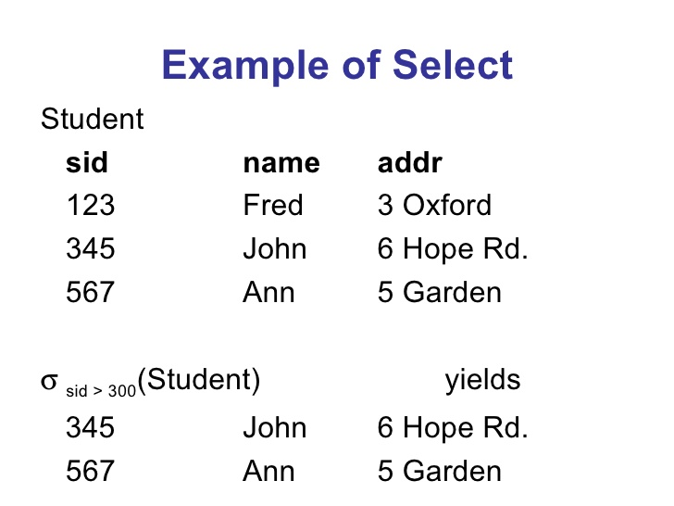
Example

Slide 9
Select
We can have comparisons using =, ≠, <, ≤, >, ≥
We can combine several presicates by connectives and (˄), or (˅), and not (¬).
Eg.
σ name = “Fred” ˅ sid = 345 (Student)

Slide 10

Project
To extract columns from a relation.
The symbol used for project is:

Slide 11
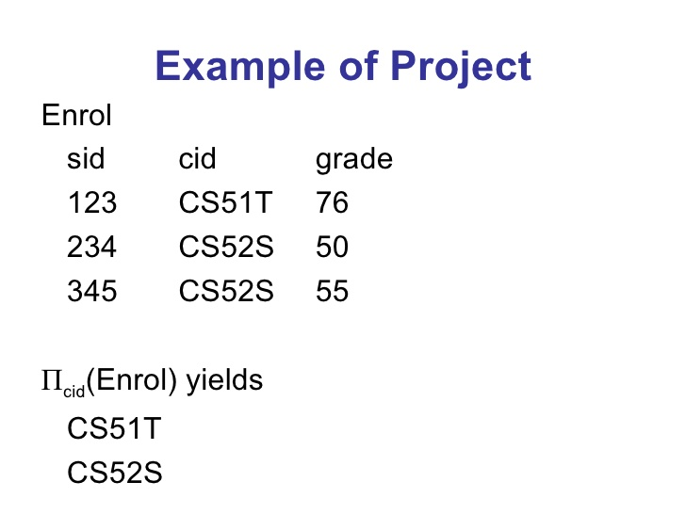
Example

Slide 12
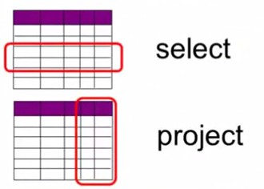
Comparison

Slide 13
Combining Select and Project
We can combine select and project.
Πsid (σ grade > 60 (Enrol))
Πsid, cid (σ grade > 60 (Enrol))

Slide 14
Practice Select and Project
employee(person-name,street,city)
works(person-name,company-name,salary)
company(company-name,city)
manages(person-name,manager-name)
1. Display the name of all employees.
2. Display the name of the employees who are managers.
3. Display the companies in the city Pune.
4. Find the names of all employees who work for “Axis Bank”.
5. Find the names of all employees who work for “Axis Bank” and have salary more than 40,000.
6. Display the address of employee “ABC”.

Slide 15
Union
Its combining the tuples that appear in any one of the relation instances.
If R U S, then it will return a relation instance with all tuples that occur in either relation instance R or S or both.

Slide 16
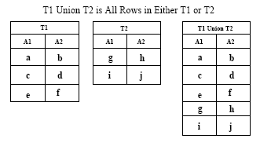
Example of Union

Slide 17
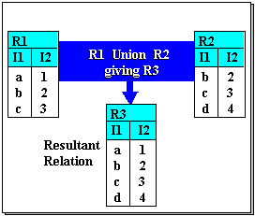
Example of Union

Slide 18
Conditions for Union
The number of attributes of both the relations should be same and similar.
The respective domains should also be same.

Slide 19
Another Type
One can have a subset of relation to participate in union.
Πcity (employee) U Πcity (company)
This will give the name of all the cities in which an employee lives or the company has a branch.

Slide 20
Set-Intersection
R ∩ S returns a relation instance containing all tuples that occur in both R and s.
Other rules for union operations are applicable here too.

Slide 21
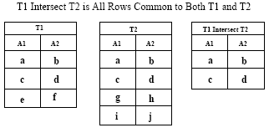
Example of Set-Intersection

Slide 22
Set-difference
R – S returns a relation instance containing tuples that are in R but not in S.
Intersection can be written in form of difference:
R ∩ S = R – (R - S)

Slide 23
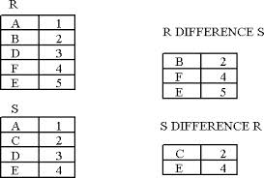
Example of Set-Difference

Slide 24
Cartesian Product
R X S contains the pair of tuples of R and S.
A tuple <r,s> will be for each pair of tuples r ϵ R, s ϵ S

Slide 25
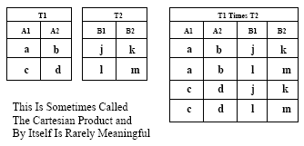
Example of Cartesian Product

Slide 26
Practice Set Operations
Borrower (customer-name, loan-number)
Depositor (customer-name, account-number)
Customer (customer-name, street-number, customer-city)
1. List all the customers who have either an account or a loan or both.
2. Find the names of all customers who have an account but not a loan.
3. List the names of all Borrowers who live in Pune.
4. List all the customers who have both a loan and an account.
5. List the name of the customers who are borrower and depositor and lives in Pune.

Slide 27
Rename
The results of relational -algebra expressions do not have a name.
It can be done as
ρx ( E )
We can name the attributes too.
ρx(A1, A2,..., An) ( E )

Slide 28

Join
Used to combine information from two or more relations.
Joins are cartesian product followed by selection or projection.
Result of a cartesian product is much larger than join.

Slide 29
Condition Join
Most commonly join operation accepts a join condition c and a pair of relation instances as arguments and returns a relation instance.
Join condition is similar to selection.
So it is a cartesian product followed by a selection.
R |><|c S = σ c (R X S)

Slide 30
Example of Condition Join
sid | sname | rating | age
22 | Dustin | 7 | 45.0
31 | Lubber | 8 | 55.5
58 | Rusty | 10 | 35.0
sid | bid | day
22 | 101 | 10/10/96
58 | 103 | 11/12/96
S1 |><|S1.sid<R1.sid R1
sid | sname | rating | age | sid | bid | day
22 | Dustin | 7 | 45.0 | 58 | 103 | 11/12/96
31 | Lubber | 8 | 55.5 | 58 | 103 | 11/12/96

Slide 31
Equijoin
Based on equality of attributes.
It is cartesian product and followed by select where tuple with equal value for the common field is retained.
Finally it is followed by project where the one of the common field is removed.
This is mostly known as Natural Join.
If the two participating relations do not have any common field then join is equivalent to cartesian product.

Slide 32
Example of Equi/Natural Join
sid | sname | rating | age
22 | Dustin | 7 | 45.0
31 | Lubber | 8 | 55.5
58 | Rusty | 10 | 35.0
sid | bid | day
22 | 101 | 10/10/96
58 | 103 | 11/12/96
S1 |><|S1.sid=R1.sid R1
Or Simply
S1 |><| R1
sid | sname | rating | age | bid | day
22 | Dustin | 7 | 45.0 | 101 | 10/10/96
58 | Rusty | 10 | 35.0 | 103 | 11/12/96

Slide 33
Practice Join
Flights(flno, from, to, distance, departs)
Aircraft(aid, aname, range)
Certified(eid, aid)
Employees(eid, ename, salary)
By definition, pilots are those employees who are certified on at least one aircraft. An aircraft can be used for any flight provided it
has sufficient range. Pilots can pilot any flight provided they are certified on an aircraft with sufficient range.
1. Find eid’s of pilots who are certified on some Boeing.
2. Find names of pilots who are certified on some Boeing.
3. Find aid’s of aircraft that can fly non-stop from LA to NY. Assume you don’t already know the distance.
4. Find names of pilots who can operate planes with a range greater than 3,000 miles, but are not certified on any Boeing.

Slide 34
Division
Two relation instances A and B, A has two fields x and y, and B has one field y. A/B is the set of all x values such that for every y value in B, there is a tuple <x,y> in A.
For each x value in A, consider the set of y values in tuples of A with that x value. If this set contains B, the x values is in the result of A/B.
The type of queries it satisfies: “Find all the customers who have an account at all the branches located in Pune” or “Find the sailors who have reserved all boats”.

Slide 35
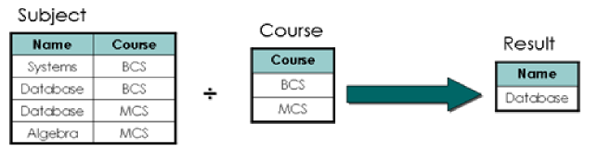

Slide 36
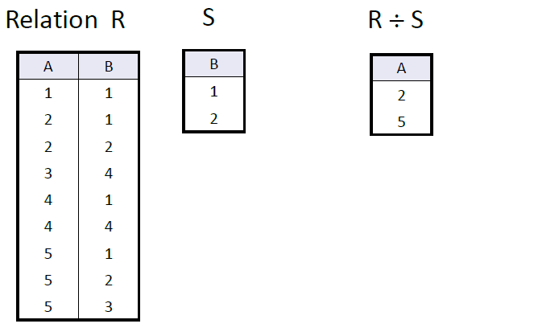

Slide 37
Assignment
Sometimes it is convenient to assign a part of relational-algebra expression to a temporary variable.
It is denoted by the symbol ←
Eg.
t1 ← Π R-S ( r )
t2 ← Π R-S ((t1 X s) - Π R-S ( r )
result = t1 - t2

Slide 38
Generalized Projection

Slide 39
Aggregate Functions
Take a collective value and return a single value as a result.
Example of Aggregate functions:
Sum
Count-distinct
Max
Min
Count
Avg
Use “as” to rename
_{branchname} g _{sum(balance) as totalbalance} (account)

Slide 40
Aggregate Operation – Example
A
B
C
Relation r:
α
α
β
β
α
β
β
β
7
7
3
10
g _{sum(c)} (r)
sum(c )
27

Slide 41
Aggregate Operation – Example
Relation account grouped by branch-name:
branch_name
account_number
balance
Perryridge
Perryridge
Brighton
Brighton
Redwood
A-102
A-201
A-217
A-215
A-222
400
900
750
750
700
_{branch_name} g _{sum(balance) as totalbalance} (account)
branch_name
totalbalance
Perryridge
Brighton
Redwood
1300
1500
700

Slide 42
Outer Join
Extension of the join operation to deal with missing information.
In Natural join, the tuples that do not match are lost.
Outer join can be used to preserve all the tuples.

Slide 43
Types of Outer Join
Left outer join: takes all tuples of first relation that do not match with second relation.
Right outer join: takes all tuples of second relation that do not match with first relation.
Full outer join: takes all tuples with both relations that are mismatched.

Slide 44
Outer Join – Example
Relation loan
loan-number
branch-name
amount
L-170
L-230
L-260
Downtown
Redwood
Perryridge
3000
4000
1700
Relation borrower
customer-name
loan-number
Jones
Smith
Hayes
L-170
L-230
L-155
Join
loan-number
branch-name
amount
customer-name
L-170
L-230
Downtown
Redwood
3000
4000
Jones
Smith
loan-number
branch-name
amount
customer-name
Left Outer Join
L-170
L-230
L-260
Downtown
Redwood
Perryridge
3000
4000
1700
Jones
Smith
null
loan-number
branch-name
amount
customer-name
Right Outer Join
L-170
L-230
L-155
Downtown
Redwood
null
3000
4000
null
Jones
Smith
Hayes

Slide 45
Full Outer Join
Outer Join
loan borrower
loan-number
branch-name
amount
customer-name
L-170
L-230
L-260
L-155
Downtown
Redwood
Perryridge
null
3000
4000
1700
null
Jones
Smith
null
Hayes

Slide 46
Null Values
It is possible for tuples to have a null value, denoted by null, for some of their attributes.
null signifies an unknown value or that a value does not exist.
The result of any arithmetic expression involving null is null.
Aggregate functions simply ignore null values.
For duplicate elimination and grouping, null is treated like any other value, and two nulls are assumed to be the same.

Slide 47
Null Values
Comparisons with null values return the special truth value unknown.
Three-valued logic using the truth value unknown:
  OR: (unknown or true) = true,
  (unknown or false) = unknown
  (unknown or unknown) = unknown
  AND: (true and unknown) = unknown,
  (false and unknown) = false,
  (unknown and unknown) = unknown
  NOT: (not unknown) = unknown
Result of select predicate is treated as false if it evaluates to unknown.

Slide 48
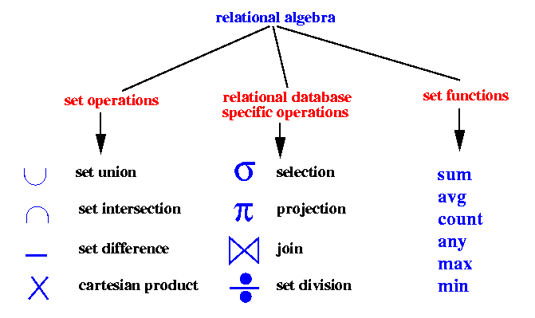
Relational Algebra Symbols

Slide 49
Modifications
Deletion
Insertion
Updating

Slide 50
Deletion
Can delete an entire tuple.
Cannot delete some of the attributes.
Syntax:
r ← r – E

Slide 51
Insertion
Either a tuple can be inserted by value or a query can be used to insert a set of tuples.
Syntax:
r ← r U E

Slide 52
Updating
To change a value in a particular tuple and not in the entire relation.
Syntax:
r ← Π F1,F2,...Fn ( r )
To update only selected tuples
r ← Π F1,F2,...Fn ( σ P (r) ) U (r - σ P (r))

Slide 53
Examples
Account ( ac_no, branch_name, balance)
Depositor(customer_name, ac_no)
Loan(loan_no, branch_name, amount)
1. Deletion
Depositor ← Depositor - σ customer_name = “ABC” (Depositor)
2. Insertion
Loan ← Loan U {(123, ABC, 3000)}
3. Updating
Account ← Π ac_no, branch_name, balance *1.5 ( Account )

Slide 54
Tuple Relational Calculus
A nonprocedural query language, where each query is of the form
{t | P (t ) }
It is the set of all tuples t such that predicate P is true for t.
t is a tuple variable, t [A ] denotes the value of tuple t on attribute A.
t ∈ r denotes that tuple t is in relation r.
P is a formula similar to that of the predicate calculus.

Slide 55
Predicate Calculus Formula
1. Set of attributes and constants
2. Set of comparison operators: (e.g., <, ≤, =, ≠, >, ≥)
3. Set of connectives: and (∧), or (v)‚ not (¬)
4. Implication (⇒): x ⇒ y, if x if true, then y is true
x ⇒ y ≡ ¬x v y
5. Set of quantifiers:
  ∃ t ∈ r (Q (t )) ≡ ”there exists” a tuple in t in relation r
  such that predicate Q (t ) is true
  ∀t ∈ r (Q (t )) ≡ Q is true “for all” tuples t in relation r

Slide 56
Banking Example
loan (loan_number, branch_name, amount )
depositor (customer_name, account_number )
borrower (customer_name, loan_number )

Slide 57
Example Queries
Find the loan_number, branch_name, and amount for loans of over $1200
{t | t ∈ loan ∧ t [amount ] > 1200}
Find the loan number for each loan of an amount greater than $1200
{t | ∃ s ∈ loan (t [loan_number ] = s [loan_number ] ∧ s [amount ] > 1200)}
loan (loan_number, branch_name, amount )
depositor (customer_name, account_number )
borrower (customer_name, loan_number )

Slide 58
Example Queries
Find the names of all customers having a loan, an account, or both at the bank
{t | ∃s ∈ borrower ( t [customer_name ] = s [customer_name ])
∨ ∃u ∈ depositor ( t [customer_name ] = u [customer_name ])
Find the names of all customers who have a loan and an account at the bank
{t | ∃s ∈ borrower ( t [customer_name ] = s [customer_name ])
∧ ∃u ∈ depositor ( t [customer_name ] = u [customer_name] )
loan (loan_number, branch_name, amount )
depositor (customer_name, account_number )
borrower (customer_name, loan_number )

Slide 59
Domain Relational Calculus
A nonprocedural query language equivalent in power to the tuple relational calculus
Each query is an expression of the form:
{ < x₁, x₂, …, x_{n} > | P (x₁, x₂, …, x_{n})}
  x₁, x₂, …, x_{n} represent domain variables
  P represents a formula similar to that of the predicate calculus

Slide 60
Example Queries
Find the loan_number, branch_name, and amount for loans of over $1200
{< l, b, a > | < l, b, a > ∈ loan ∧ a > 1200}
Find the names of all customers who have a loan of over $1200
{< c > | ∃ l, b, a (< c, l > ∈ borrower ∧ < l, b, a > ∈ loan ∧ a > 1200)}
Find the names of all customers who have a loan from the Perryridge branch and the loan amount:
{< c, a > | ∃ l (< c, l > ∈ borrower ∧ ∃b (< l, b, a > ∈ loan ∧ b = “Perryridge”))}
{< c, a > | ∃ l (< c, l > ∈ borrower ∧ < l, “ Perryridge”, a > ∈ loan)}
loan (loan_number, branch_name, amount )
depositor (customer_name, account_number )
borrower (customer_name, loan_number )

